Slide 1
Exploring Data with Graphs

Slide 2
Aims
How to present data clearly
The Chart Builder
Graphs
Histograms
Boxplots
Error bar charts
Scatterplots

Slide 3
The Chart Builder

Slide 4
The Chart Builder

Slide 5
Histograms: Spotting Obvious Mistakes

Slide 6
Histograms
Histograms plot:
The score (x-axis)
The frequency (y-axis)
Histograms help us to identify:
The shape of the distribution
Skew
Kurtosis
Spread or variation in scores
Unusual scores
Notes:
Can be simple boxplot for frequency/percentage of one variable (place on x)
Can be population pyramid or stacked for two variables (one with levels, other with frequency)

Slide 7
Histograms
Does wishing upon a star make all your dreams come true?
Measured success of 250 people using a composite measure (salary, quality of life, how close life matches aspirations)
Success:
Score ranged from 0 to 100
0 = Complete failure
100 = Complete success
Participants randomly allocated to
Wish upon a star, or
Work as hard as they can for next 5 years.
Success measured again after 5 years.
Notes:
Jiminy_cricket.sav

Slide 8
Histograms

Slide 9
Histograms

Slide 10
Histograms

Slide 11
Boxplots
Boxplots are made up of a box and two whiskers.
The box shows:
The median
The upper and lower quartile
The limits within which the middle 50% of scores lie.
The whiskers show
The limits within which the top and bottom 25% of scores lie
Notes:
Can be for one variable (1-d boxplot, on x axis)
Can be for two variables (simple or clustered), level variable on x, by y/outcome

Slide 12
Boxplots

Slide 13
Boxplots

Slide 14
Boxplots

Slide 15
Bar Charts w/ Error Bars
The bar shows the mean score
The error bar sticks out from the bar like a whisker, displays.
The confidence interval (usually 95%)
The standard deviation
The standard error of the mean

Slide 16
Bar Charts w/ Error Bars

Slide 17
Bar Chart: One Independent Variable
Are romance films more exciting than others?
Participants:
20 men
20 women
Half of each sample saw one of two films:
A ‘romance film’ (Bridget Jones’ Diary),
A ‘control’ (Memento).
Outcome measure
Physiological arousal as an indicator of how much they enjoyed the film.
Notes:
RomanceFilm.sav

Slide 18
Bar Chart: Bivariate Relationship

Slide 19
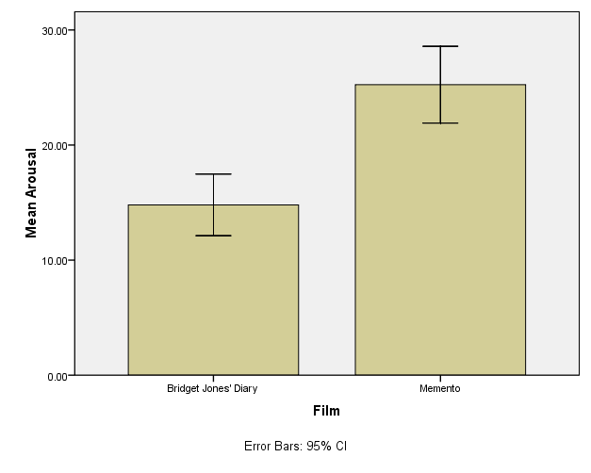
Bar Chart: Bivariate Relationship
Notes:
One IV/DV

Slide 20
Bar Chart: Multivariate Relationship
Notes:
Two independent variables

Slide 21
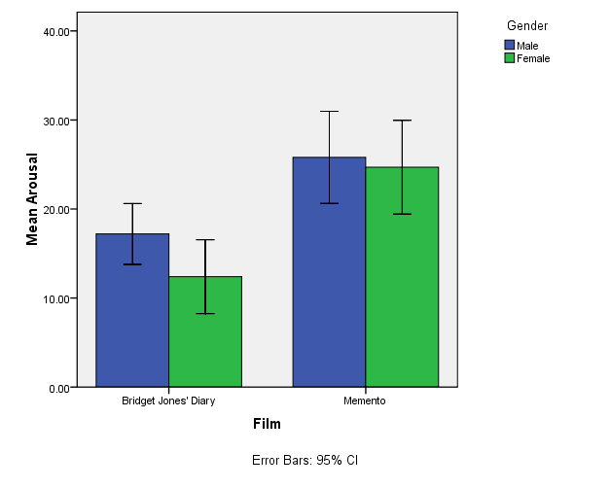
Bar Chart: Multivariate Relationship

Slide 22
Scatterplots
Does anxiety influence exam performance?
Participants:
103 students
Measures
Time spent revising (hours)
Exam performance (%)
Exam Anxiety (the EAQ, score out of 100)
Gender
Notes:
More than just “related to” and is impact/influence/closer-to-causal because anxiety was measured BEFORE exam score.
ExamAnxiety.sav

Slide 23
Scatterplots

Slide 24
Simple Scatterplot

Slide 25
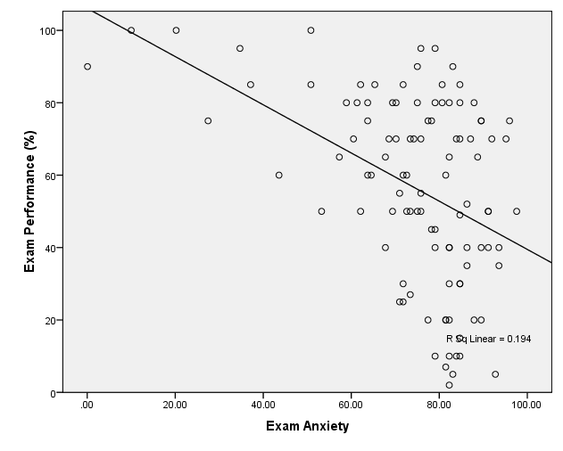
Simple Scatterplot

Slide 26
Grouped Scatterplot

Slide 27
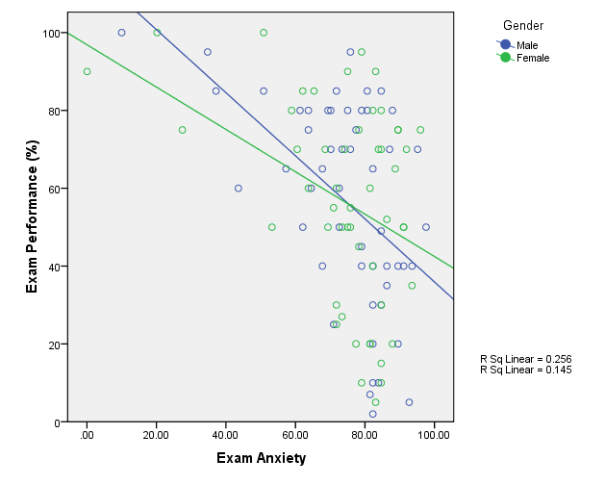
Grouped Scatterplot

Slide 28
Matrix Scatterplot

Slide 29
Matrix Scatterplot

